Slide 1
Discrete Event Simulation Fundamentals
Define Discrete Event Simulation.
Define concepts (entities, attributes, event list, etc…)
Define “world-view”, or how discrete event simulation operates
Example hand simulation

Slide 2
ETM 607 – Discrete Event Simulation Fundamentals
System – a collection of entities that act and interact toward the accomplishment of some logical end.
State – the state of a system is the collection of variables necessary to describe the status of the system at any given time.
Discrete – a discrete system is one in which the state variables change only at discrete or countable points in time.
Continuous– a continuous system is one in which the state variables change continuously over time.

Slide 3
ETM 607 – Discrete Event Simulation Fundamentals
Static – a static simulation model is a representation of a system at a particular point in time.
Dynamic – a dynamic simulation is a representation of a system as it evolves over time.
Deterministic – a deterministic simulation model is one that contains no random variables. All variables are known with certainty, or in other words, no probability is associated with them.
Stochastic– a stochastic simulation model contains random variables (variables containing probability distributions).

Slide 4
Pieces of a Simulation Model
Entities
  “Players” that move around, change status, affect and are affected by other entities
  Dynamic objects — get created, move around, leave (maybe)
  Usually have multiple realizations floating around
  Can have different types of entities concurrently
  Usually, identifying the types of entities is the first thing to do in building a model

Slide 5
Pieces of a Simulation Model (cont’d.)
Attributes
  Characteristic of all entities: describe, differentiate
  All entities have same attribute “slots” but different values for different entities, for example:
    Time of arrival
    Due date
    Priority
    Color
  Attribute value tied to a specific entity
  Like “local” (to entities) variables

Slide 6
Pieces of a Simulation Model (cont’d.)
Event
  An instantaneous occurrence that changes the state of a system (such as the completion of a service, or the arrival of an entity).
Event notice
  A record of an event to occur at the current or some future time, along with any associated data necessary to execute the event; at a minimum the record includes the event type and the event time.
Event list
  A list of event notices for future events, ordered by time of occurrence; also known as the Future Events List.

Slide 7
Pieces of a Simulation Model (cont’d.)
Activity
  A duration of time of specified length (e.g. a service time or inter-arrival time), which is known when it begins (although it may be defined in terms of a statistical distribution).
Delay
  A duration of time of unspecified indefinite length, which is not known until it ends (e.g. a customer’s delay in a last-in-first-out waiting line which, when it begins, depends on future arrivals).
Simulation Clock
  A variable representing simulated time.

Slide 8
Pieces of a Simulation Model (cont’d.)
Resources
  What entities compete for
    People
    Equipment
    Space
  Entity seizes a resource, uses it, releases it
  Think of a resource being assigned to an entity, rather than an entity “belonging to” a resource
  “A” resource can have several units of capacity
    Seats at a table in a restaurant
    Identical ticketing agents at an airline counter
  Number of units of resource can be changed during the simulation

Slide 9
Pieces of a Simulation Model (cont’d.)
Queues
  Place for entities to wait when they can’t move on (maybe since the resource they want to seize is not available)
  Have names, often tied to a corresponding resource
  Can have a finite capacity to model limited space — have to model what to do if an entity shows up to a queue that’s already full
  Usually watch the length of a queue, waiting time in it

Slide 10
Pieces of a Simulation Model (cont’d.)
Statistical accumulators
  Variables that “watch” what’s happening
  Depend on output performance measures desired
  “Passive” in model — don’t participate, just watch
  At end of simulation, used to compute final output performance measures

Slide 11
Pieces of a Simulation Model (cont’d.)
Statistical accumulators for the simple processing system
  Number of parts produced so far
  Total of the waiting times spent in queue so far
  No. of parts that have gone through the queue
  Max time in queue we’ve seen so far
  Total of times spent in system
  Max time in system we’ve seen so far
  Area so far under queue-length curve Q(t)
  Max of Q(t) so far
  Area so far under server-busy curve B(t)

Slide 12
Simulation Dynamics:
The Event-Scheduling “World View”
Identify characteristic events
Decide on logic for each type of event to
  Effect state changes for each event type
  Observe statistics
  Update times of future events (maybe of this type, other types)
Keep a simulation clock, future event calendar
Jump from one event to the next, process, observe statistics, update event calendar
Must specify an appropriate stopping rule
Usually done with general-purpose programming language (C, FORTRAN, etc.)

Slide 13
The System:
A Simple Processing System
Machine
(Server)
Arriving
Blank Parts
Departing
Finished Parts
7
6
5
4
Queue (FIFO)
Part in Service
General intent:
  Estimate expected production
  Waiting time in queue, queue length, proportion of time machine is busy
Time units
  Can use different units in different places … must declare
  Be careful to check the units when specifying inputs
  Declare base time units for internal calculations, outputs
  Be reasonable (interpretation, roundoff error)

Slide 14
Model Specifics
Initially (time 0) empty and idle
Base time units: minutes
Input data (assume given for now …), in minutes:
Part Number Arrival Time Interarrival Time Service Time
1 0.00 1.73 2.90
2 1.73 1.35 1.76
3 3.08 0.71 3.39
4 3.79 0.62 4.52
5 4.41 14.28 4.46
6 18.69 0.70 4.36
7 19.39 15.52 2.07
8 34.91 3.15 3.36
9 38.06 1.76 2.37
10 39.82 1.00 5.38
11 40.82 . .
. . . .
. . . .
Stop when 20 minutes of (simulated) time have passed

Slide 15
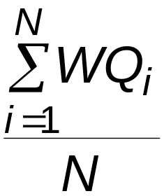
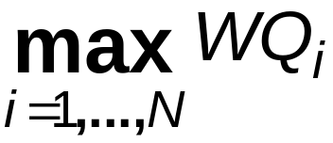
Goals of the Study:
Output Performance Measures
Total production of parts over the run (P)
Average waiting time of parts in queue:
Maximum waiting time of parts in queue:
N = no. of parts completing queue wait
WQ_{i} = waiting time in queue of ith part
Know: WQ₁ = 0 (why?)
N > 1 (why?)

Slide 16
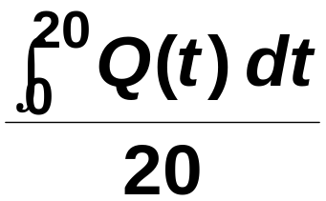
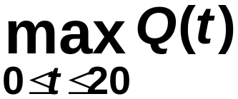
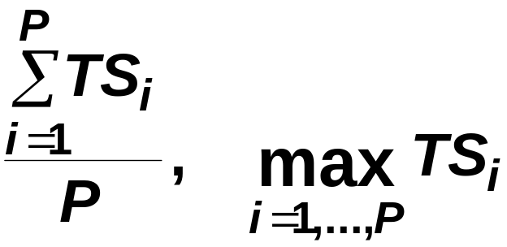
Goals of the Study:
Output Performance Measures (cont’d.)
Time-average number of parts in queue:
Maximum number of parts in queue:
Average and maximum total time in system of parts (a.k.a. cycle time):
Q(t) = number of parts in queue
at time t
TS_{i} = time in system of part i

Slide 17
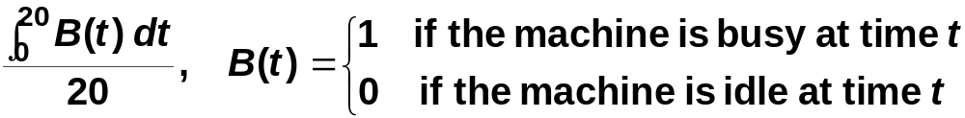
Goals of the Study:
Output Performance Measures (cont’d.)
Utilization of the machine (proportion of time busy)
Many others possible (information overload?)

Slide 18
Events for the
Simple Processing System
Arrival of a new part to the system
  Update time-persistent statistical accumulators (from last event to now)
    Area under Q(t)
    Max of Q(t)
    Area under B(t)
  “Mark” arriving part with current time (use later)
  If machine is idle:
    Start processing (schedule departure), Make machine busy, Tally waiting time in queue (0)
  Else (machine is busy):
    Put part at end of queue, increase queue-length variable
  Schedule the next arrival event

Slide 19
Events for the
Simple Processing System (cont’d.)
Departure (when a service is completed)
  Increment number-produced stat accumulator
  Compute & tally time in system (now - time of arrival)
  Update time-persistent statistics (as in arrival event)
  If queue is non-empty:
    Take first part out of queue, compute & tally its waiting time in queue, begin service (schedule departure event)
  Else (queue is empty):
    Make the machine idle (Note: there will be no departure event scheduled on the future events calendar, which is as desired)

Slide 20
Events for the
Simple Processing System (cont’d.)
The End
  Update time-persistent statistics (to end of the simulation)
  Compute final output performance measures using current (= final) values of statistical accumulators
After each event, the event calendar’s top record is removed to see what time it is, what to do
Also must initialize everything

Slide 21
Some Additional Specifics for the
Simple Processing System
Simulation clock variable (internal in Arena)
Event calendar: list of event records:
  [Entity No., Event Time, Event Type]
  Keep ranked in increasing order on Event Time
  Next event always in top record
  Initially, schedule first Arrival, The End (Dep.)
State variables: describe current status
  Server status B(t) = 1 for busy, 0 for idle
  Number of customers in queue Q(t)
  Times of arrival of each customer now in queue (a list of random length)

Slide 22
Simulation by Hand
Manually track state variables, statistical accumulators
Use “given” interarrival, service times
Keep track of event calendar
“Lurch” clock from one event to the next
Will omit times in system, “max” computations here (see text for complete details)

Slide 23
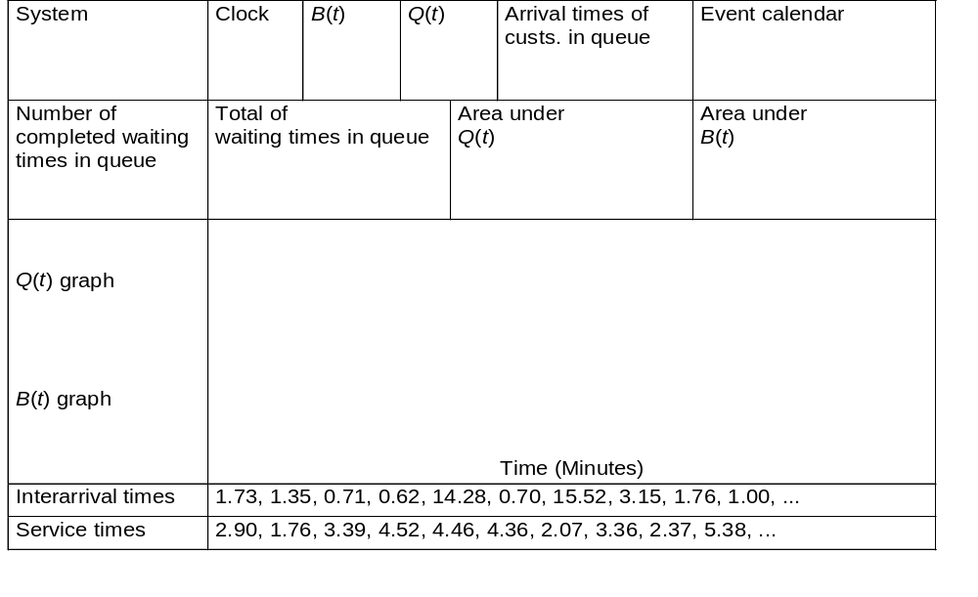
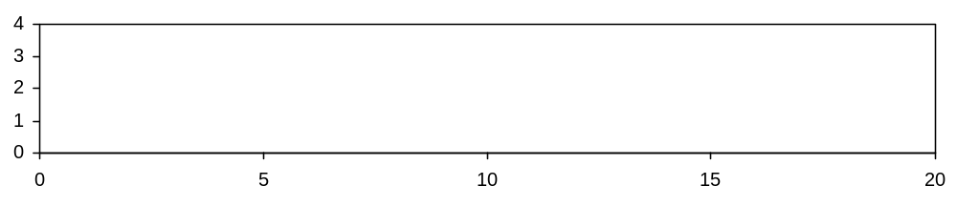
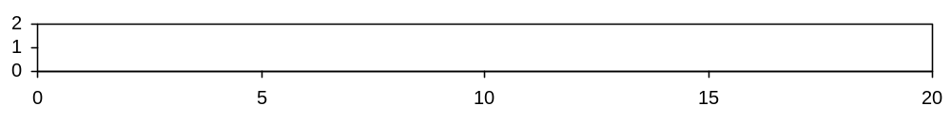
Simulation by Hand:
Setup

Slide 24
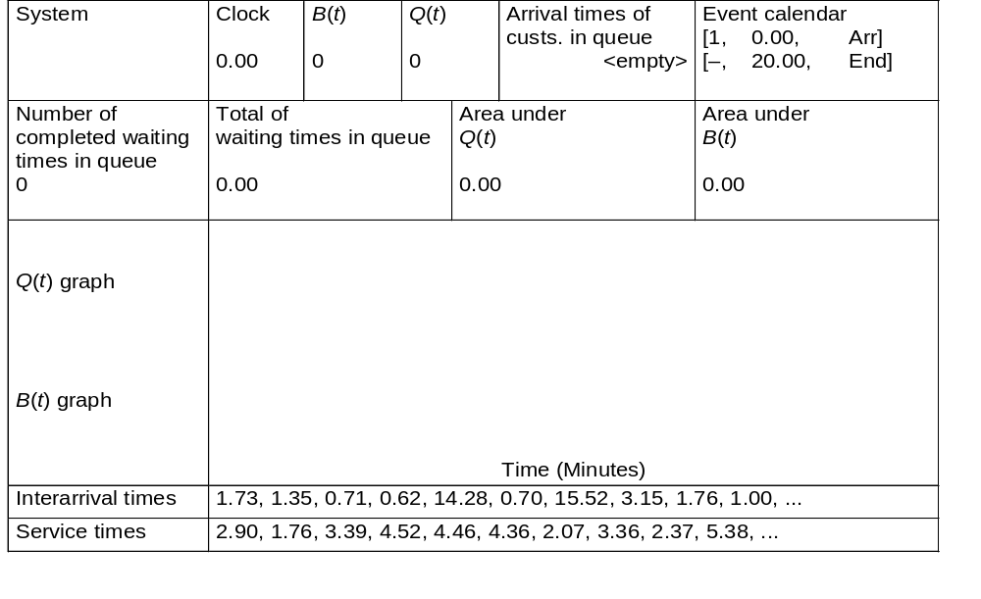
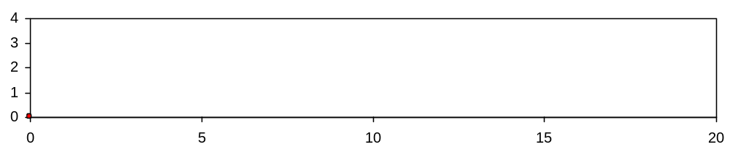
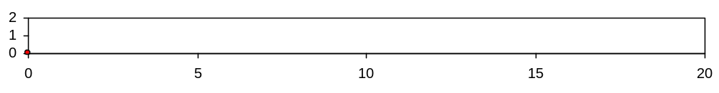
Simulation by Hand: t = 0.00, Initialize

Slide 25
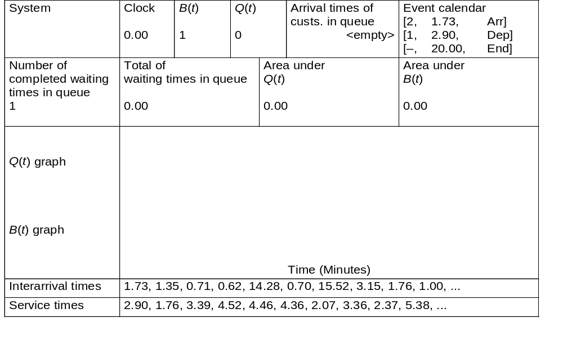

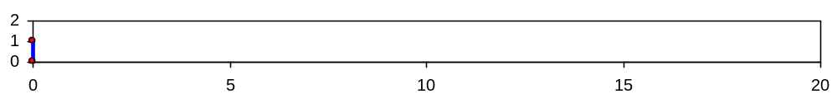
Simulation by Hand: t = 0.00, Arrival of Part 1
1

Slide 26
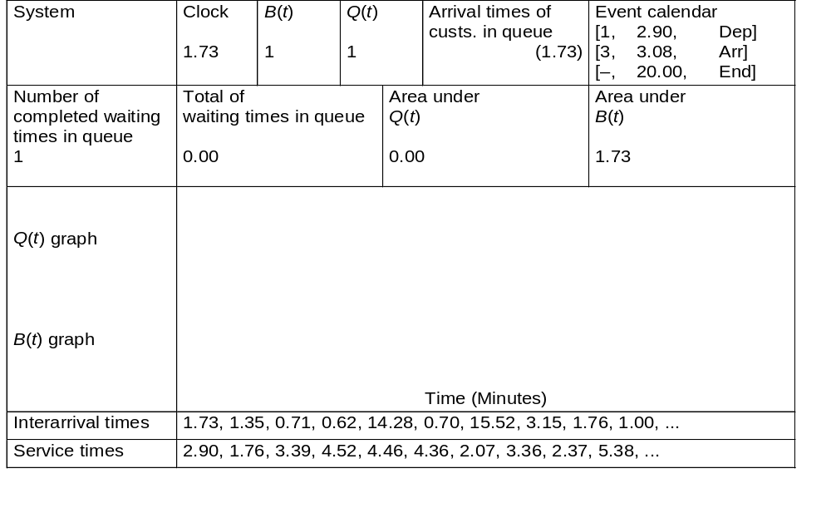
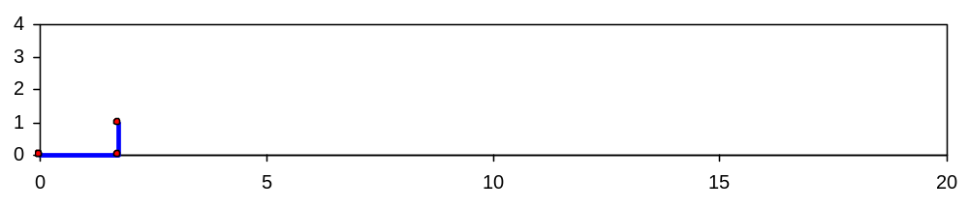
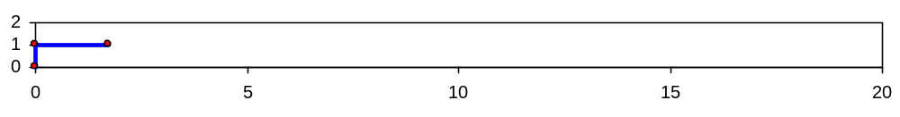
Simulation by Hand: t = 1.73, Arrival of Part 2
2
1

Slide 27

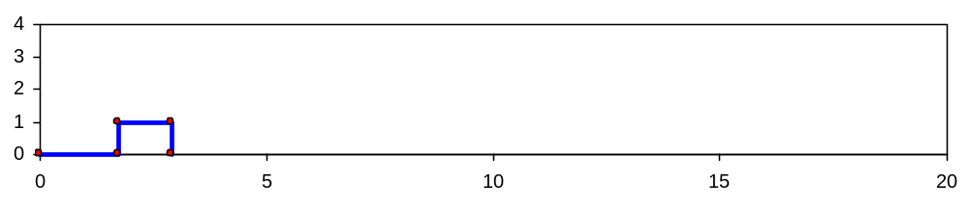
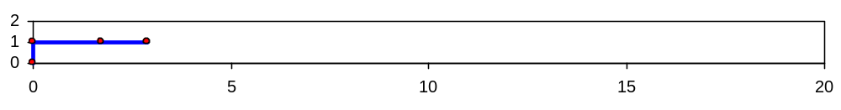
Simulation by Hand: t = 2.90, Departure of Part 1
2

Slide 28
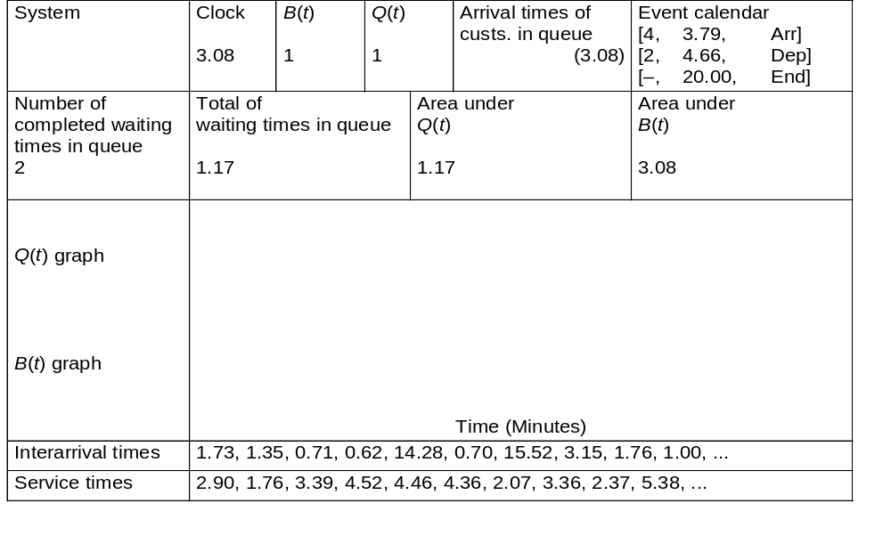
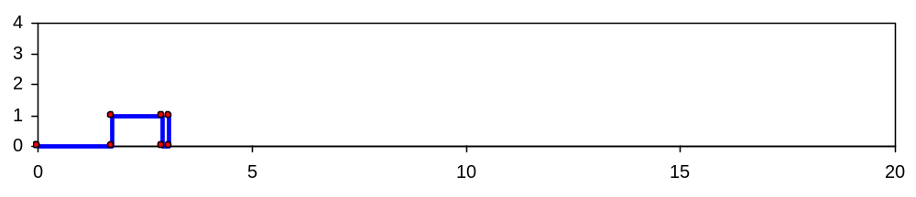
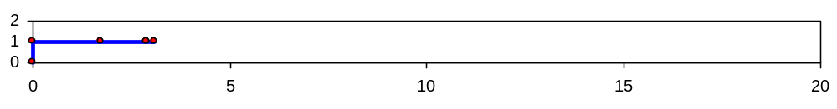
Simulation by Hand: t = 3.08, Arrival of Part 3
3
2

Slide 29

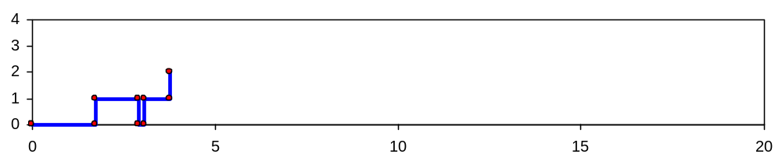
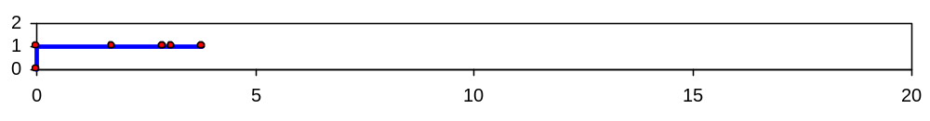
Simulation by Hand: t = 3.79, Arrival of Part 4
4
3
2

Slide 30

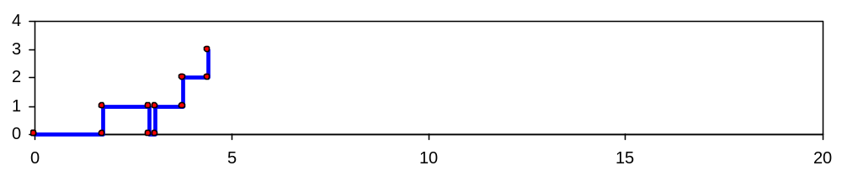
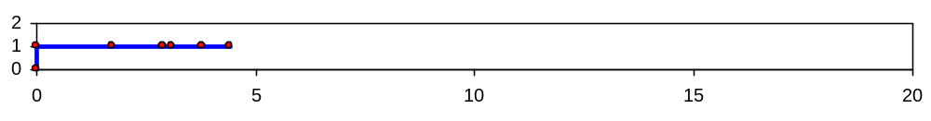
Simulation by Hand: t = 4.41, Arrival of Part 5
5
4
3
2

Slide 31
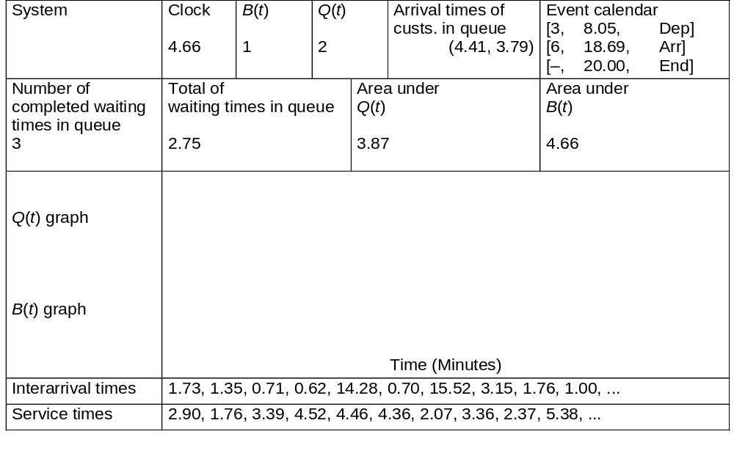
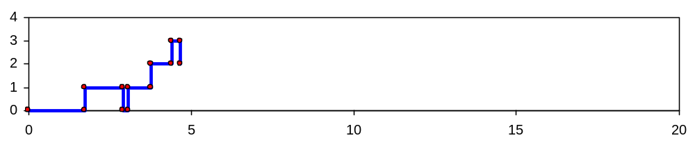
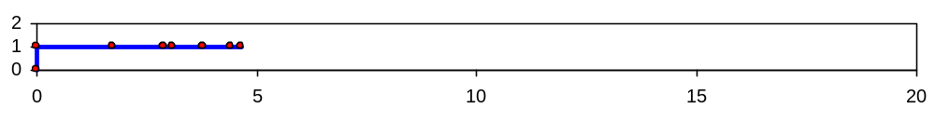
Simulation by Hand: t = 4.66, Departure of Part 2
5
4
3

Slide 32
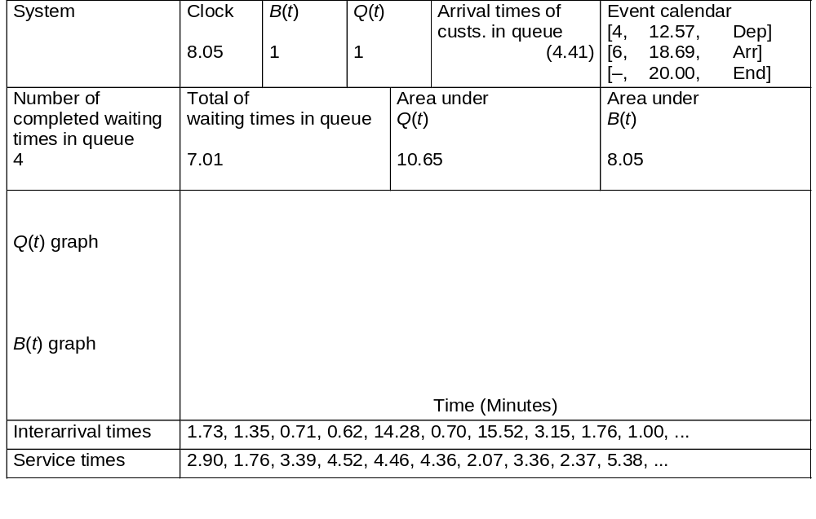
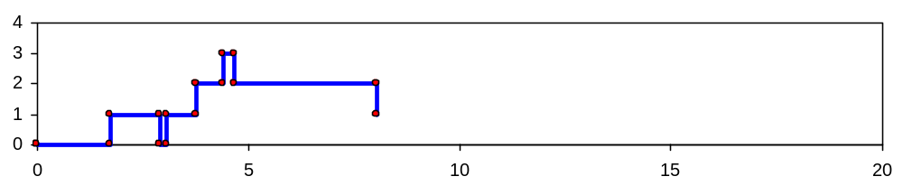
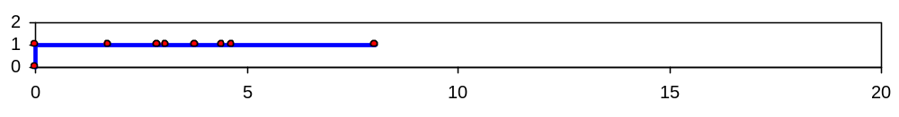
Simulation by Hand: t = 8.05, Departure of Part 3
5
4

Slide 33
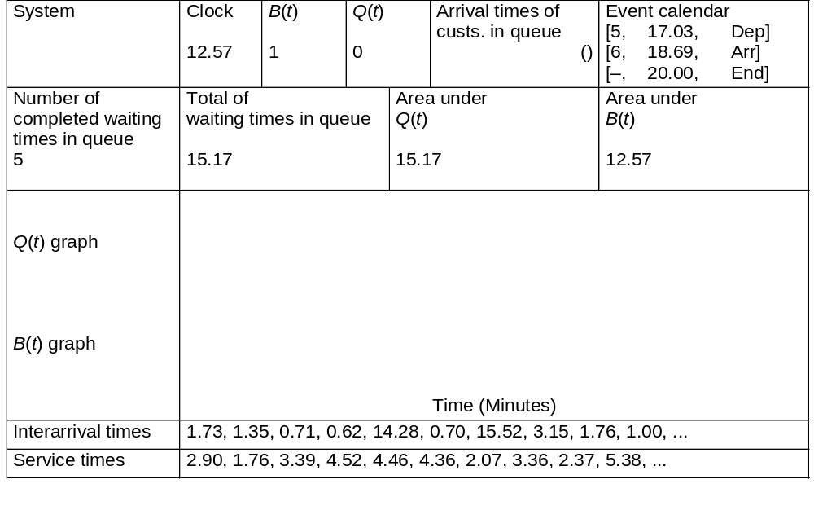
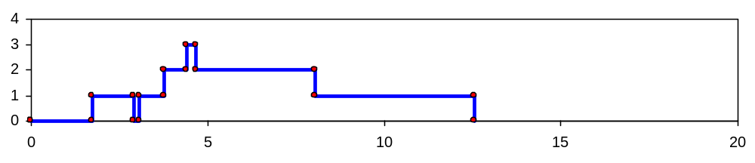
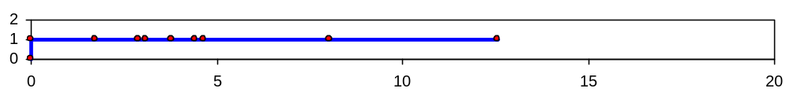
Simulation by Hand: t = 12.57, Departure of Part 4
5

Slide 34
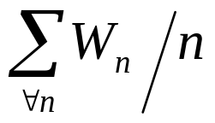
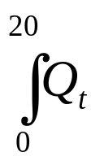
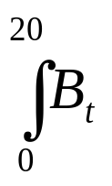
Simulation by Hand: t = 12.57, Departure of Part 4
Your Turn – In Class Exercise:
Complete hand simulation through time 20.
Compute summary statistics
  Average waiting time in queue:
  Time-average number in queue:
  Utilization of drill press:

Slide 35
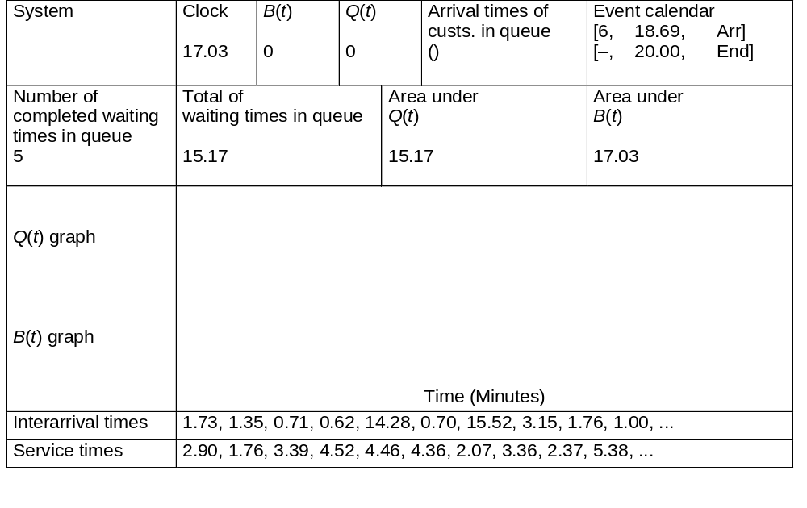
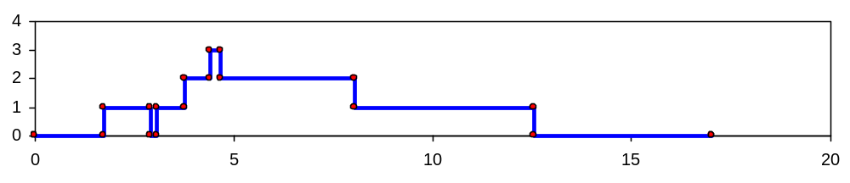
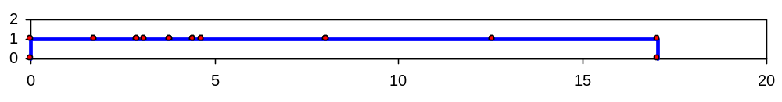
Simulation by Hand: t = 17.03, Departure of Part 5

Slide 36

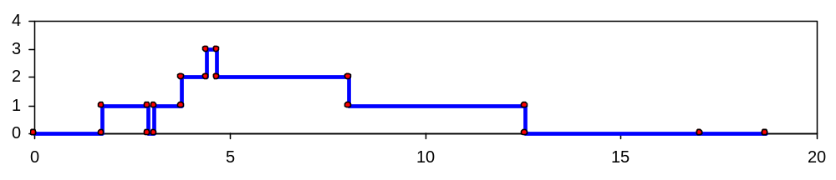
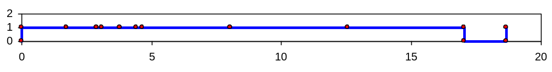
Simulation by Hand: t = 18.69, Arrival of Part 6
6

Slide 37
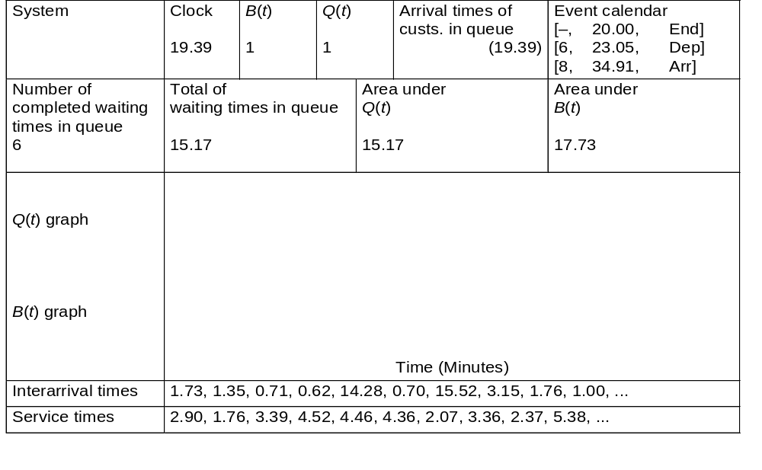
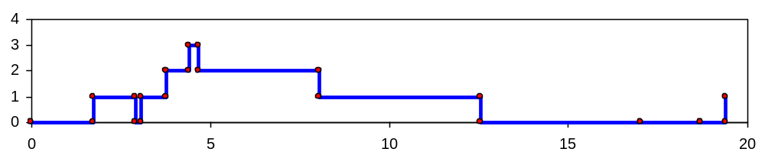
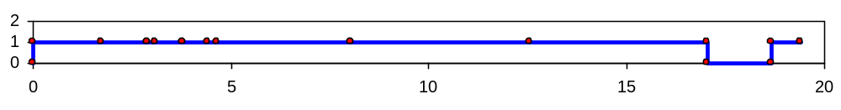
Simulation by Hand: t = 19.39, Arrival of Part 7
7
6

Slide 38
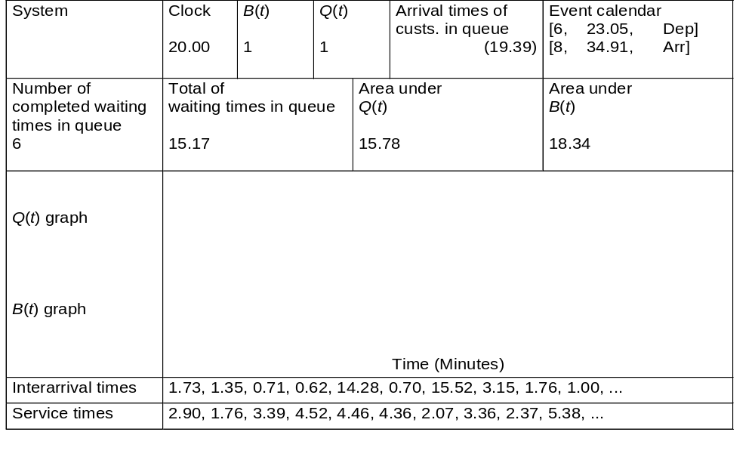
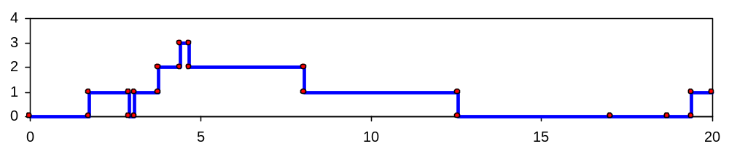
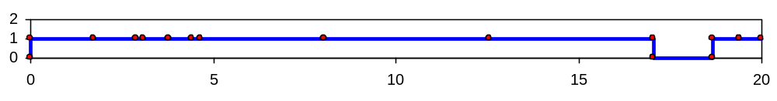
Simulation by Hand: t = 20.00, The End
7
6

Slide 39
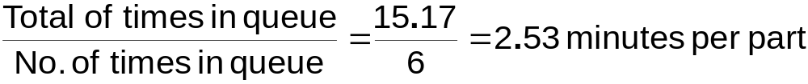

Simulation by Hand:
Finishing Up
Average waiting time in queue:
Time-average number in queue:
Utilization of drill press:

Slide 40

Complete Record of the Hand Simulation

Slide 41
Event-Scheduling Logic via Programming
Clearly well suited to standard programming language
Often use “utility” libraries for:
  List processing
  Random-number generation
  Random-variate generation
  Statistics collection
  Event-list and clock management
  Summary and output
Main program ties it together, executes events in order

Slide 42
Simulation Dynamics: The Process-Interaction World View
Identify characteristic entities in the system
Multiple copies of entities co-exist, interact, compete
“Code” is non-procedural
Tell a “story” about what happens to a “typical” entity
May have many types of entities, “fake” entities for things like machine breakdowns
Usually requires special simulation software

Slide 43
The Game of Life
Board game - theoretically infinite two-dimensional array of cells. Each cell can hold one “organism” and has eight neighboring cells, including those diagonally adjacent. Initially, some cells occupied. The following rules apply:
1. Every organism with two or three neighboring organisms
survives for the next generation.
2. Every organism with four or more neighbors dies from
overpopulation.
3. Every organism with one neighbor or none dies from isolation.
4. Each empty cell adjacent to exactly three occupied neighbors
will give birth to an organism.
These rules were derived by Conway “after a long period of experimentation.”
6.<number>

Slide 44
Simple Fun Examples of Cellular Automata
“Sharks and Fishes”
An ocean could be modeled as a three-dimensional array of cells.
Each cell can hold one fish or one shark (but not both).
Fish and sharks follow “rules.”
6.<number>

Slide 45
Fish
Might move around according to these rules:
If there is one empty adjacent cell, the fish moves to this cell.
2. If there is more than one empty adjacent cell, the fish moves to one cell chosen at random.
3. If there are no empty adjacent cells, the fish stays where it is.
4. If the fish moves and has reached its breeding age, it gives birth to a baby fish, which is left in the vacating cell.
5. Fish die after x generations.
6.<number>

Slide 46
Sharks
Might be governed by the following rules:
1. If one adjacent cell is occupied by a fish, the shark moves to this cell and eats the fish.
2. If more than one adjacent cell is occupied by a fish, the shark chooses one fish at random, moves to the cell occupied by the fish, and eats the fish.
3. If no fish are in adjacent cells, the shark chooses an unoccupied adjacent cell to move to in a similar manner as fish move.
4. If the shark moves and has reached its breeding age, it gives birth to a baby shark, which is left in the vacating cell.
5. If a shark has not eaten for y generations, it dies.
6.<number>

Slide 47

Sample Student Output
6.<number>
6.68

Slide 48
Sharks and Fish
S&F 1. Fish alone move continuously subject to an external current and Newton's laws.
S&F 2. Fish alone move continuously subject to gravitational attraction and Newton's laws.
S&F 3. Fish alone play the "Game of Life" on a square grid.
S&F 4. Fish alone move randomly on a square grid, with at most one fish per grid point.
S&F 5. Sharks and Fish both move randomly on a square grid, with at most one fish or shark per grid point, including rules for fish attracting sharks, eating, breeding and dying.
S&F 6. Like Sharks and Fish 5, but continuous, subject to Newton's laws.
Notes:
CS267 Lecture 2
SF2: like HW2 but no collisions
SF4: need to keep at most one fish per cell,
so need to deal with possible races, deadlock
SF6: rules, not implementation

Slide 49
Discrete Event Systems
Notes:
CS267 Lecture 2

